Slide 1


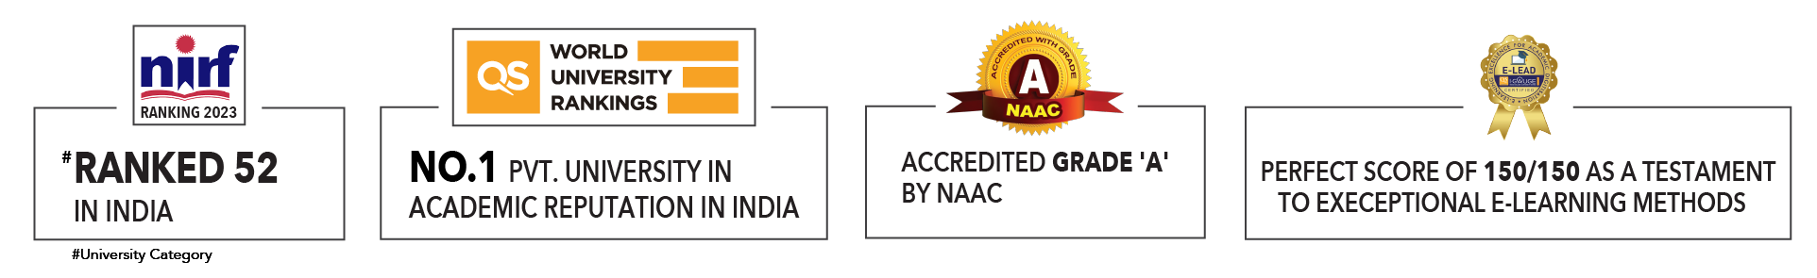

Slide 2

Unit 2 : Logic for AI
Prepared by
Dr. Khushboo Jain
School of Computer Science UPES, Dehradun
India

Slide 3
Table of Contents
Propositional logic
Predicate logic
Resolution
Resolution in proportional logic
Resolution in predicate logic
Clause form
Unification algorithm

Slide 4
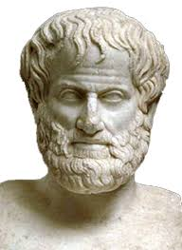
Introduction to Logic
What is Logic?
The study of principles and methods used to distinguish correct reasoning from incorrect reasoning.
Father of Logic
Aristotle (384–322 BCE): Often considered the "father of logic," Aristotle developed the first formal system of logic, known as syllogistic logic. His work, particularly in "Organon," laid the groundwork for future logical studies.

Slide 5
Propositional Logic
Propositional logic is also known as propositional calculus or sentential logic.
It is a branch of logic that deals with propositions and their relationships through logical connectives.
It forms the foundation for many areas of formal logic, computer science, and mathematics.

Slide 6
Propositions
A proposition is a declarative statement that is either True or False but not both.
Examples include:
"It is raining" (True or False)
"2 + 2 = 4" (True).

Slide 7
Logical Connectives
Connectives: Symbols representing logical operations.
Types of Connectives:
Negation (¬) : The negation of a proposition P is denoted as ¬P and is True if P is False, and False if P is True.
Conjunction (∧) : The conjunction of propositions P and Q is denoted as P∧Q and is True if both P and Q are True.
Disjunction (∨) : The disjunction of propositions P and Q is denoted as P∨Q and is True any one of P or Q is True.
Implication (→) : The implication P→Q is true if whenever P is True, Q is also True. It is False only if P is True and Q is False.
Bi-implication (↔) : The biconditional P↔Q is true if P and Q are either both True or both False.

Slide 8
Truth Tables
Purpose: Systematically determine the truth value of compound propositions.
Construction: Assign truth values to variables and apply logical connectives.
Example: Truth table for (𝑝∧𝑞)∨¬𝑝

Slide 9
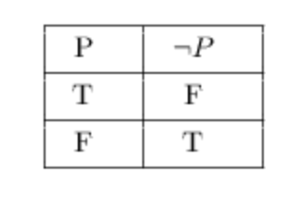
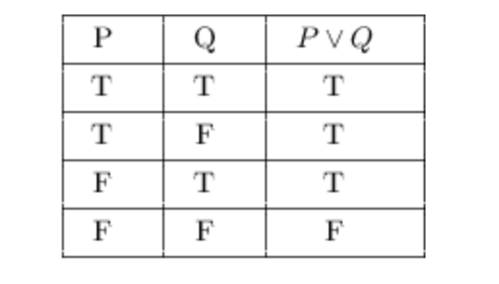
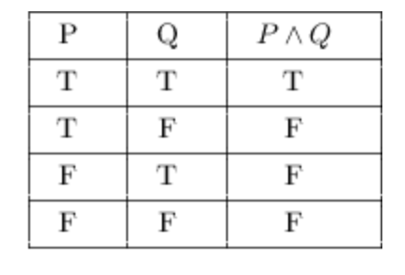
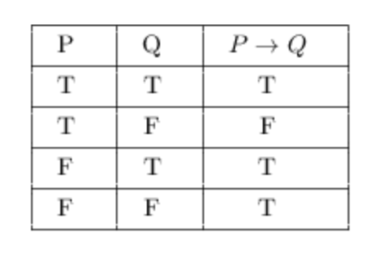
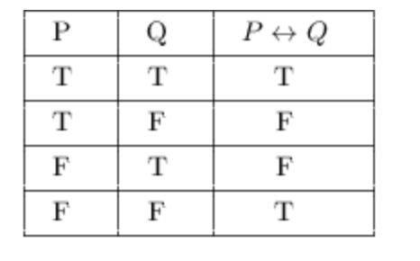
Truth Table Examples
For a detailed tutorial on Truth Tables, please refer to: https://sites.millersville.edu/bikenaga/math-proof/truth-tables/truth-tables.html

Slide 10
Laws of Propositional Logic
Commutative Laws: 𝑝∧𝑞 ≡ 𝑞∧𝑝
Associative Laws: (𝑝∧𝑞)∧𝑟 ≡ 𝑝∧(𝑞∧𝑟)
Distributive Laws: 𝑝∧(𝑞∨𝑟) ≡ (𝑝∧𝑞)∨(𝑝∧𝑟)
De Morgan's Laws: ¬(𝑝∧𝑞) ≡ ¬𝑝∨¬𝑞
Idempotent Laws: 𝑝∧𝑝 ≡ 𝑝
Example: Applying De Morgan's Law: ¬(𝑝∨𝑞) ≡ ¬𝑝∧¬𝑞

Slide 11
Examples
Simplify the expression ¬(p∨q)∧(p→q)

Slide 12
Solution
Simplifying the expression ¬(p∨q)∧(p→q)
1. Apply De Morgan's Law to ¬(p∨q) :
¬(p∨q)≡¬p∧¬q
2. Apply the definition of implication to p→q:
p→q≡¬p∨q
3. Substitute these into the original expression:
(¬p∧¬q)∧(¬p∨q)
4. Distribute ¬p across (¬p∧¬q) and (¬p∨q) :
(¬p∧¬q)∧(¬p∨q)≡(¬p∧¬q∧¬p)∨(¬p∧¬q∧q)
5. Simplify the expression:
(¬p∧¬q∧¬p)∨(¬p∧¬q∧q)≡¬p∧¬q
So, the simplified expression is:
¬p∧¬q

Slide 13
What is Predicate Logic?
Predicate Logic: Deals with predicates and quantified variables.
Predicates: Statements containing variables that can be either true or false.
Quantifiers: Symbols indicating the extent of the variable's applicability (e.g., ∀ for universal quantification, ∃ for existential quantification).
Example: ∀𝑥(𝑃(𝑥)) represents "for all x, P(x)".

Slide 14
Predicates and Quantifiers
Predicates: Expressions containing variables that can be true or false.
Quantifiers: Determine the scope of variables.
Examples:
Predicate: 𝑃(𝑥) - "x is a prime number."
Quantified Statement: ∀𝑥(𝑃(𝑥)) - "All x are prime numbers."

Slide 15
Quantifier Negation
Negating Quantified Statements:
Universal Quantification: ¬(∀𝑥(𝑃(𝑥)))≡∃𝑥(¬𝑃(𝑥))
Existential Quantification: ¬(∃𝑥(𝑃(𝑥)))≡∀𝑥(¬𝑃(𝑥))
Example:
Negating "All cats are mammals"
becomes
"Some cats are not mammals".

Slide 16
Rules of Inference
Modus Ponens: If 𝑝 implies 𝑞 and 𝑝 is true, then 𝑞 is true.
Modus Tollens: If 𝑝 implies 𝑞 and 𝑞 is false, then 𝑝 is false.
Hypothetical Syllogism: If 𝑝 implies 𝑞, and 𝑞 implies 𝑟, then 𝑝 implies 𝑟.
Disjunctive Syllogism: If 𝑝 or 𝑞 is true, and ¬𝑝 is true, then 𝑞 is true.
Constructive Dilemma: If 𝑝 implies 𝑞, and 𝑟 implies 𝑠, and 𝑝∨𝑟 is true, then 𝑞∨𝑠 is true.
Example: Using Modus Ponens: If "It is raining" implies "The ground is wet", and "It is raining", then "The ground is wet".

Slide 17
Predicate Logic Inference Rules
Universal Instantiation: If ∀𝑥(𝑃(𝑥)) is true, then 𝑃(𝑎) is true for any individual 𝑎.
Existential Instantiation: If ∃𝑥(𝑃(𝑥)) is true, then 𝑃(𝑎) is true for some particular 𝑎.
Universal Generalization: If 𝑃(𝑎) is true for any individual 𝑎, then ∀𝑥(𝑃(𝑥)) is true.
Existential Generalization: If 𝑃(𝑎) is true for some particular 𝑎, then ∃𝑥(𝑃(𝑥)) is true.
Example: Using Universal Instantiation: If "All cats are mammals", then "Fluffy is a mammal".

Slide 18
Predicate Logic Equivalences
Universal Quantifier Equivalence:
¬∀𝑥(𝑃(𝑥))≡∃𝑥(¬𝑃(𝑥))
Existential Quantifier Equivalence:
¬∃𝑥(𝑃(𝑥))≡∀𝑥(¬𝑃(𝑥))
Negation Equivalence:
¬(∀𝑥(𝑃(𝑥)))≡∃𝑥(¬𝑃(𝑥)) and ¬(∃𝑥(𝑃(𝑥)))≡∀𝑥(¬𝑃(𝑥))

Slide 19
Applications of Logic
Mathematics: Proving theorems, solving equations.
Computer Science: Designing algorithms, programming languages.
Philosophy: Analyzing arguments, studying language.
Linguistics: Understanding sentence structure, semantics.
Example: Using logic to verify software correctness.

Slide 20
What is Resolution?
Resolution Method is an inference rule which is used in both proposition as well as First order predicate logic (FOPL) in different ways.
This method is basically used for proving the satisfiability of a sentence.
In resolution method, we use “Proof by Refutation” technique to prove the given statement.

Slide 21
What is Resolution?
The Key idea for the resolution method is to use the knowledge base and negated goal to obtain null clause (which indicates contradiction).
Resolution method is also called Proof by Refutation. Since the knowledge base itself is consistent, the contradiction must be introduced by a negated goal.
As a result , we have to conclude that the original goal is true.

Slide 22
Resolution Method in AI
There are two methods for resolution in AI:
Resolution Method in Proposition logic
Resolution Method in Predicate logic

Slide 23
Resolution Method in Propositional Logic
In propositional logic, the resolution method is only the reference rule which gives a new clause when two or more clauses are coupled together.
Using propositional logic, it becomes easy to make a theorem prover sound and complete for all.

Slide 24
The process followed to convert the propositional logic into resolution method contains the below steps:
Convert the given axiom into clause form, i.e., Disjunction form.
Apply and proof the given goal using negotiation rule.
Using those literals which are needed to prove.
Solve the clause together and achieve the goal.
Resolution Method in Propositional Logic

Slide 25
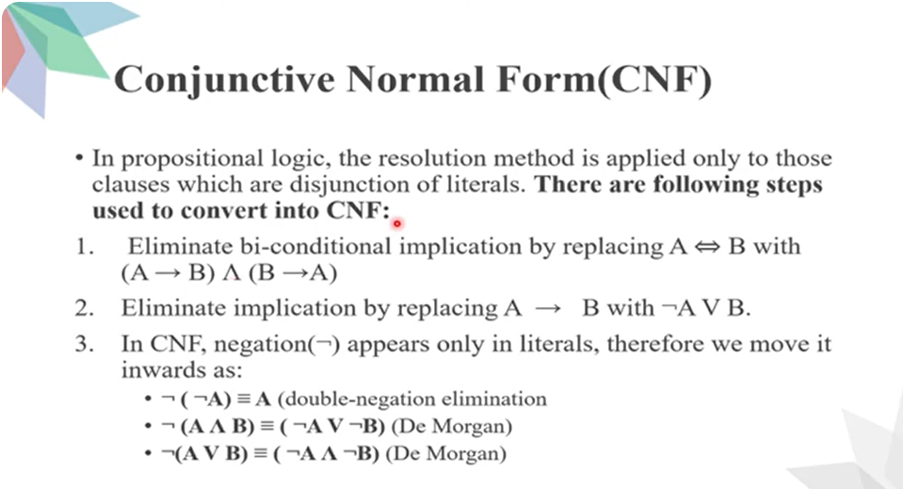

Slide 26
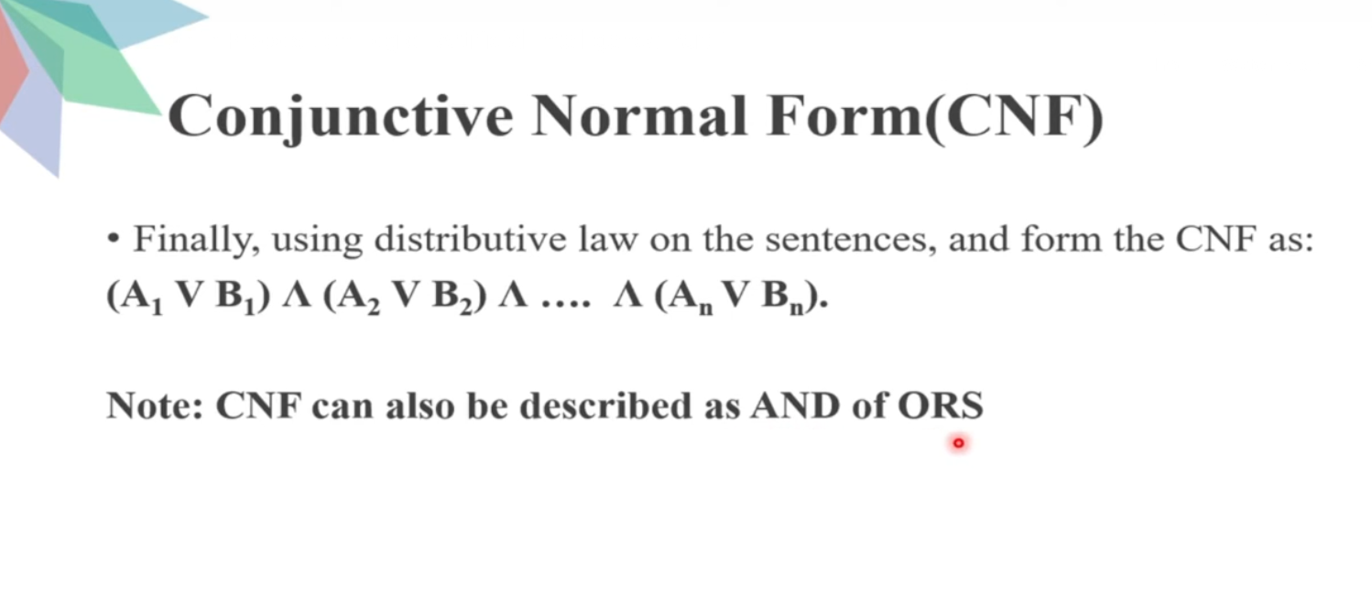

Slide 27
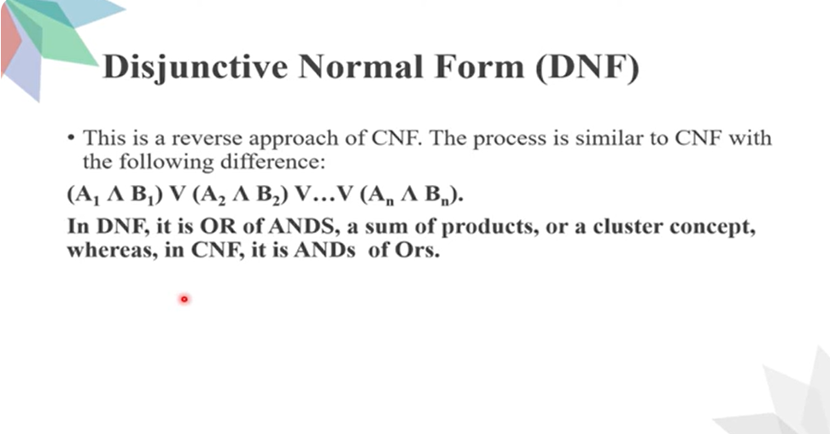

Slide 28
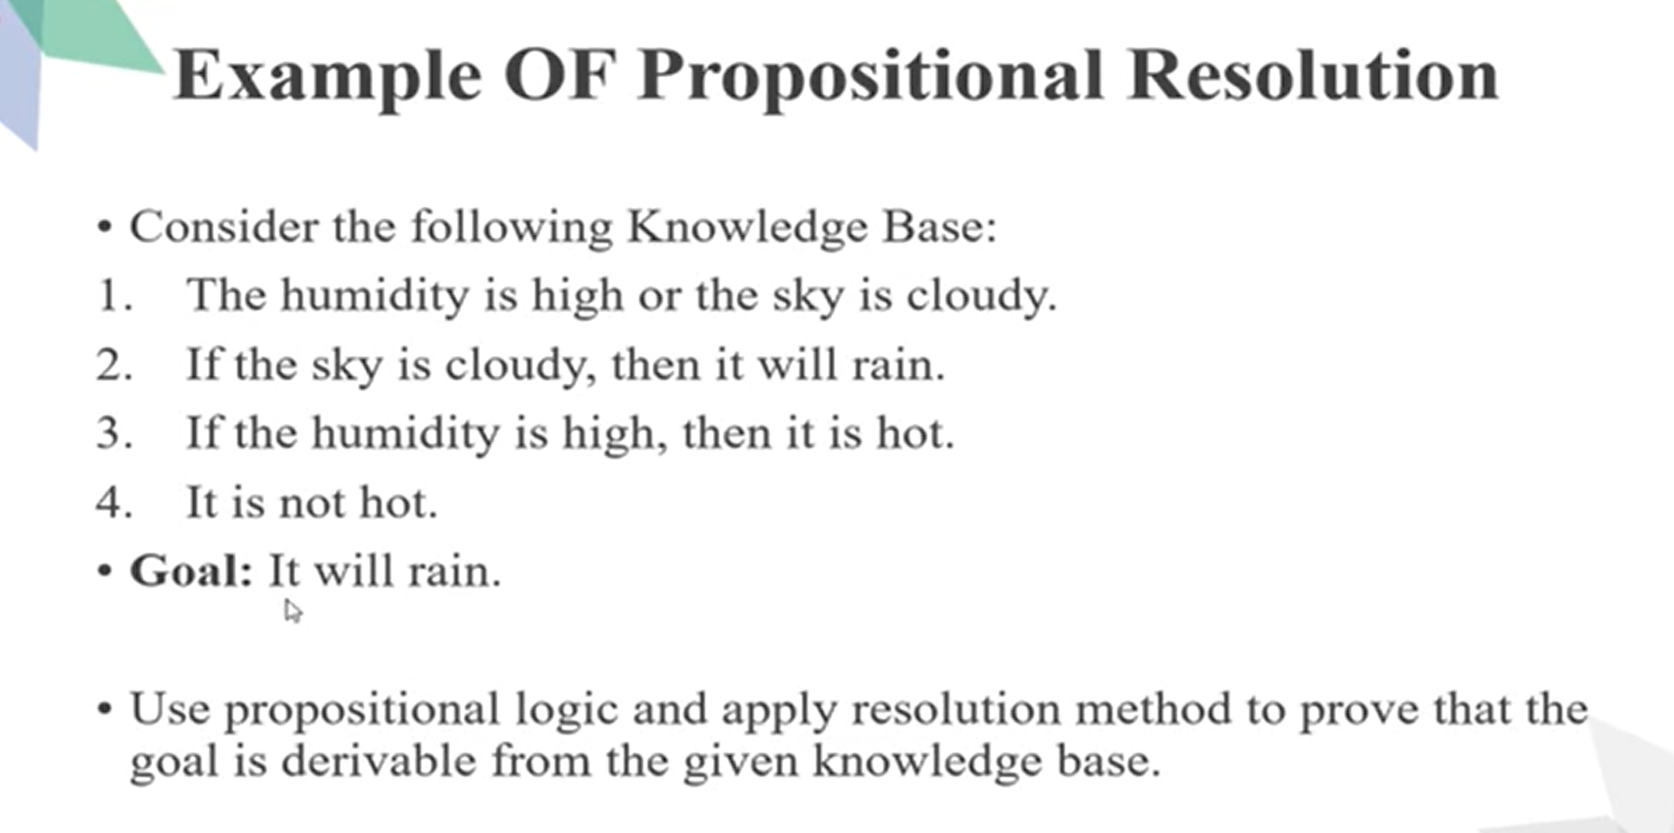

Slide 29
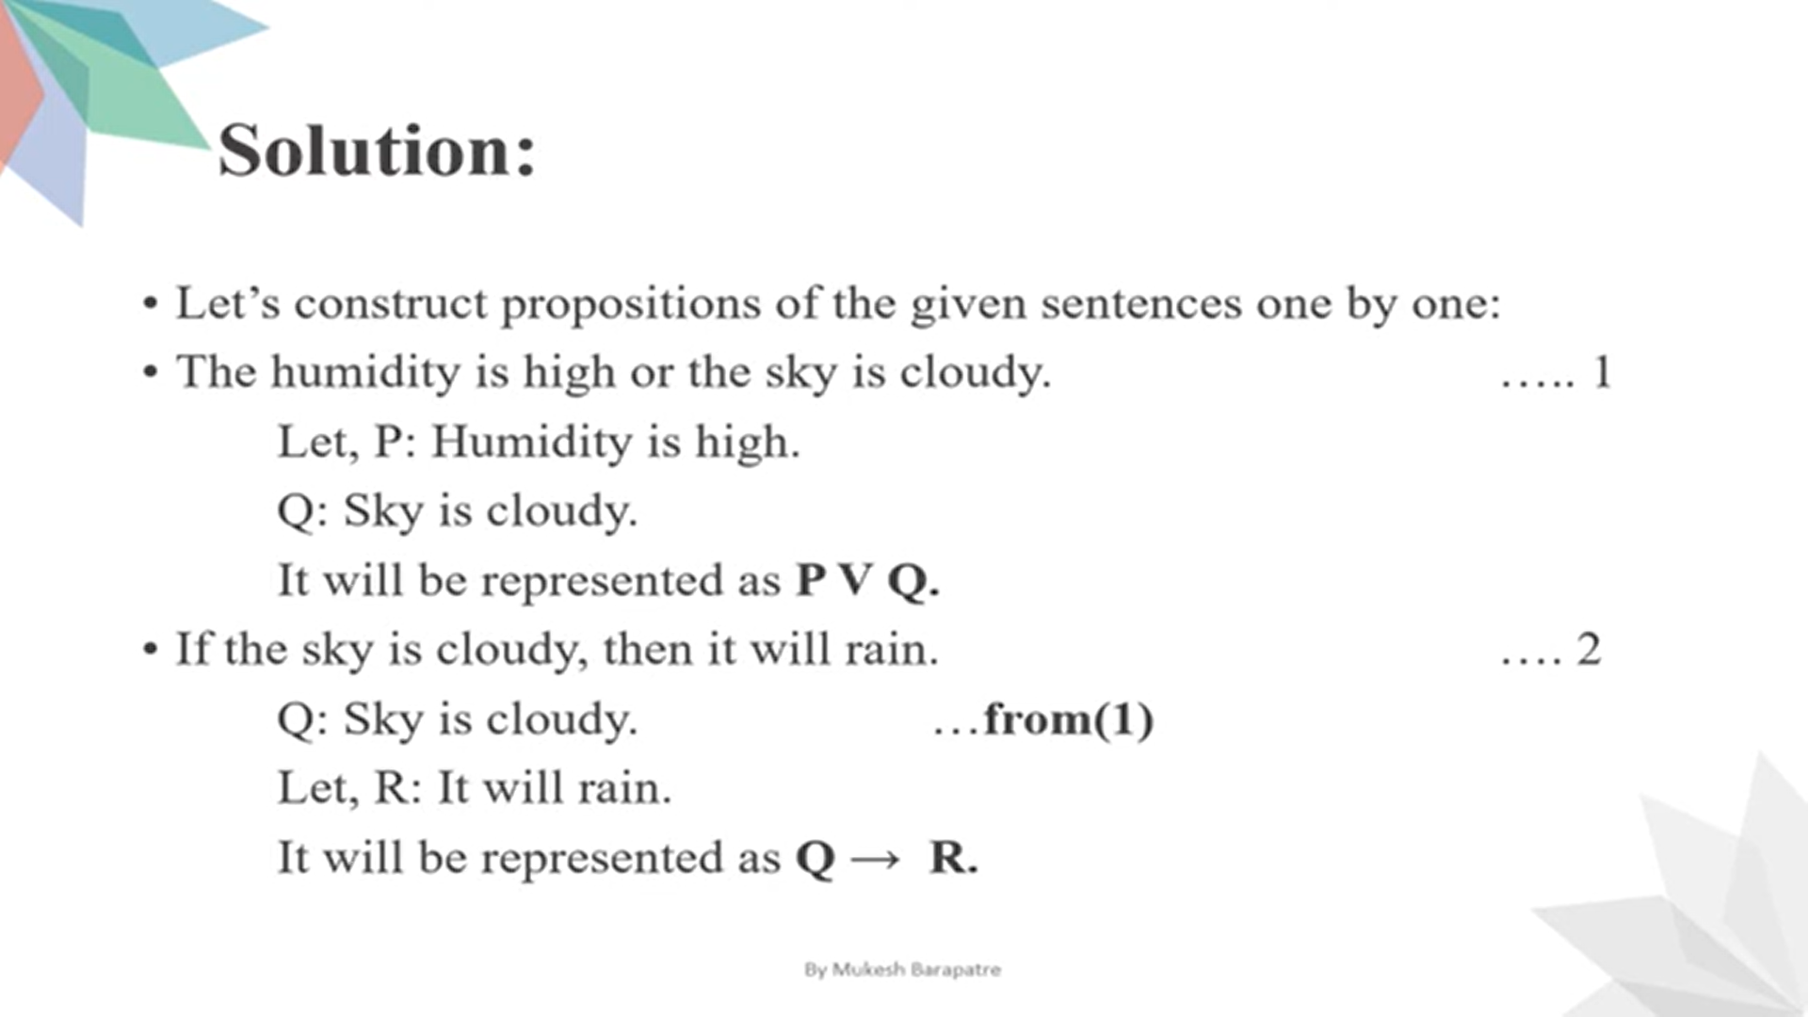

Slide 30
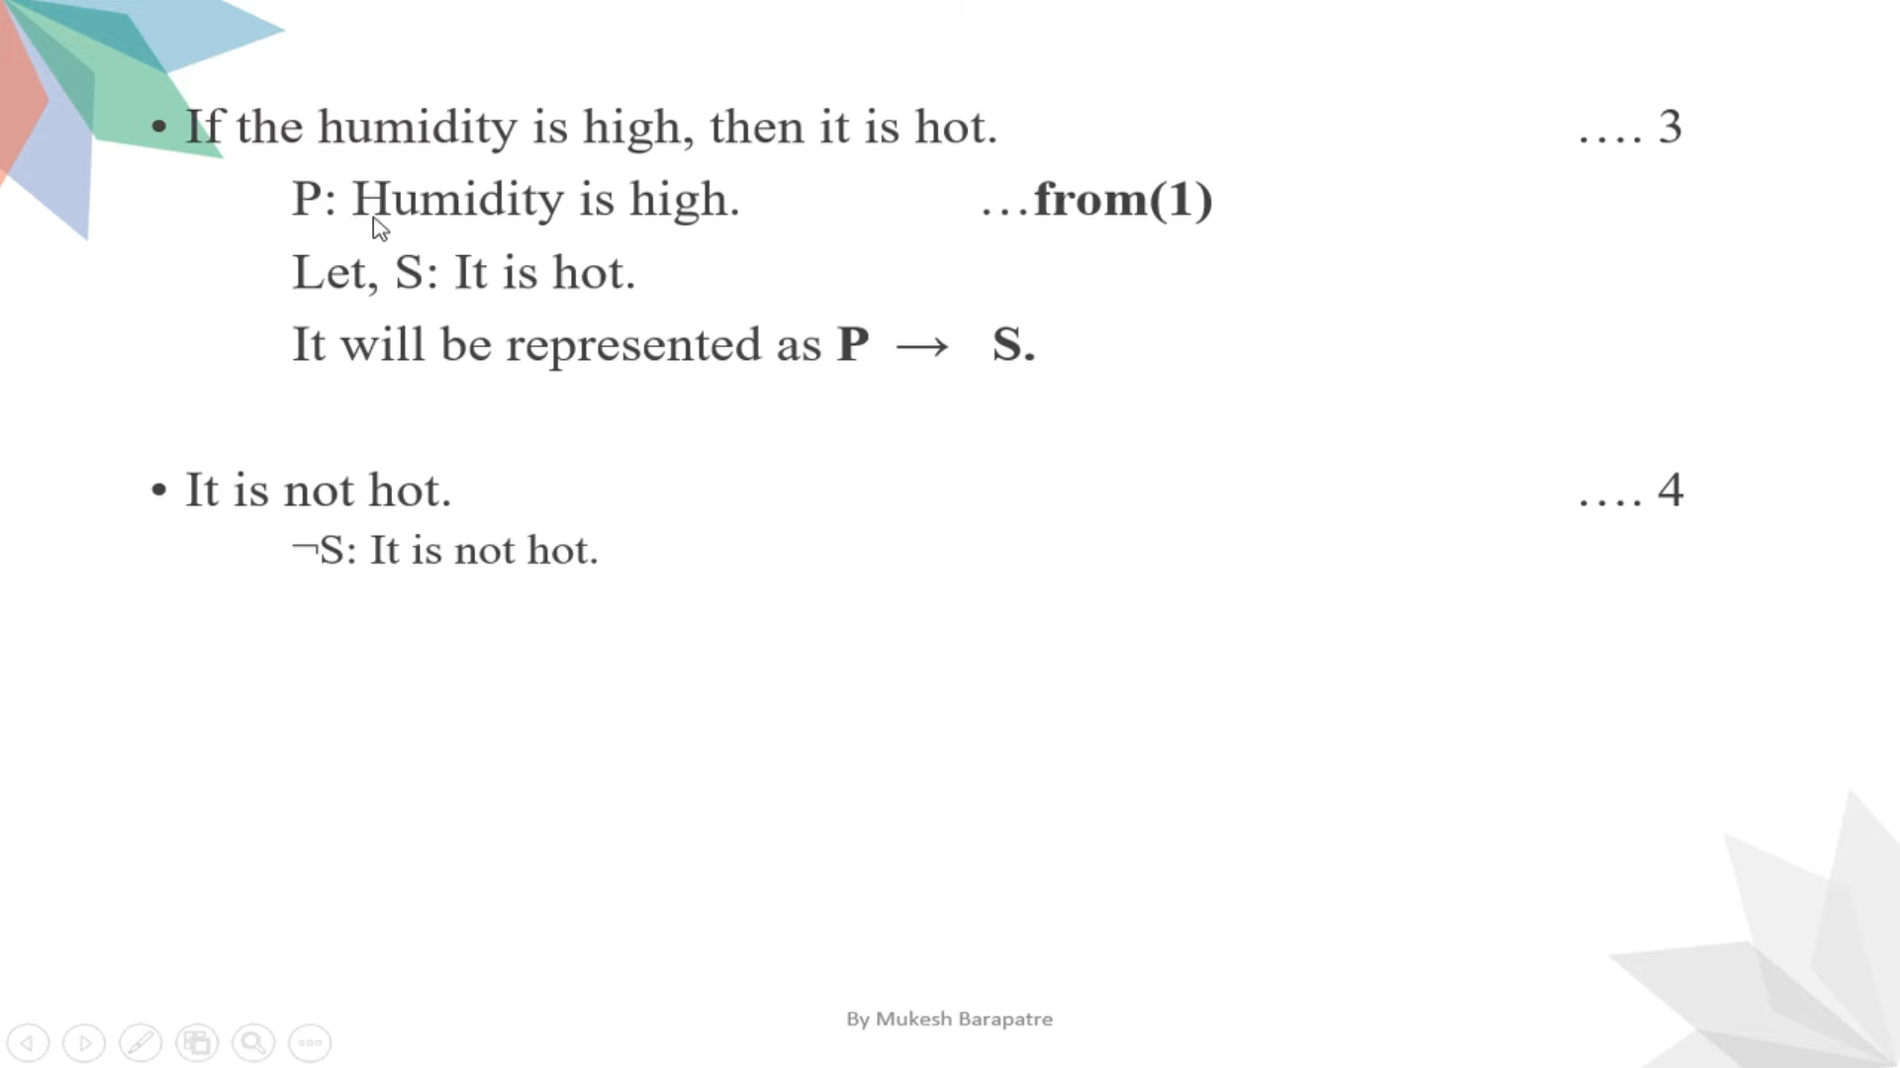

Slide 31
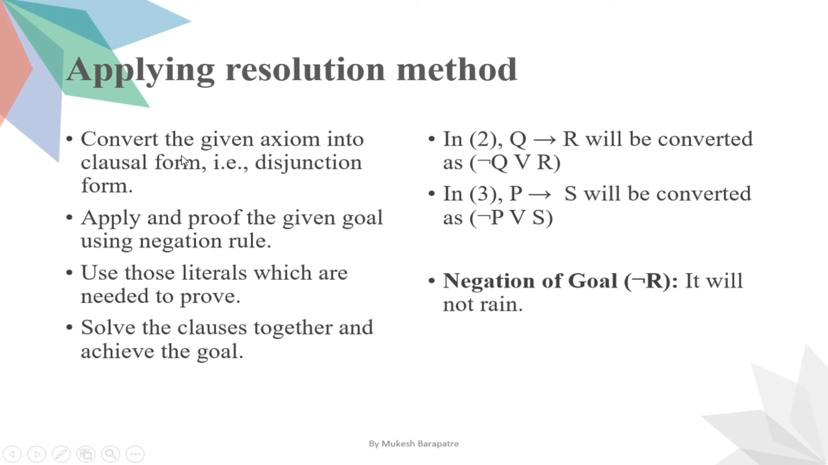

Slide 32
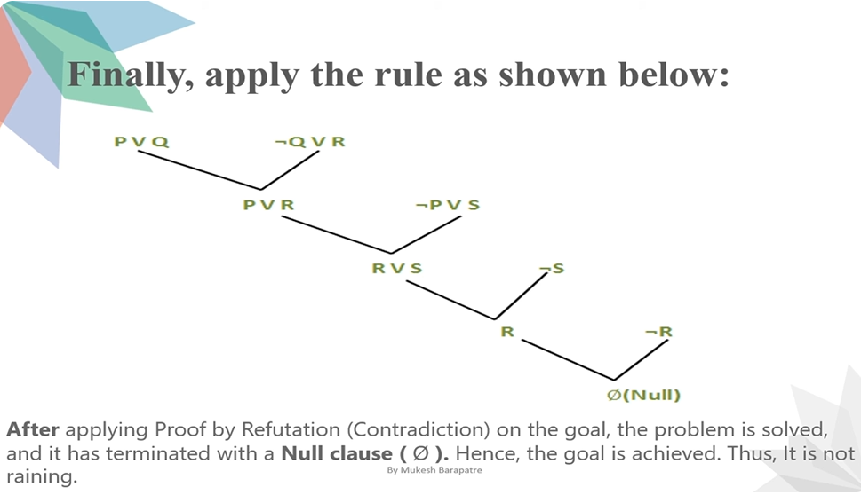

Slide 33
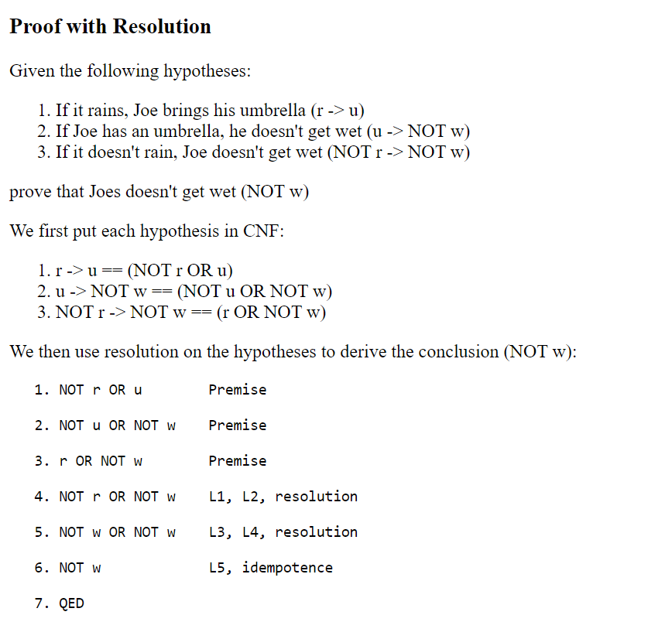
Example:

Slide 35
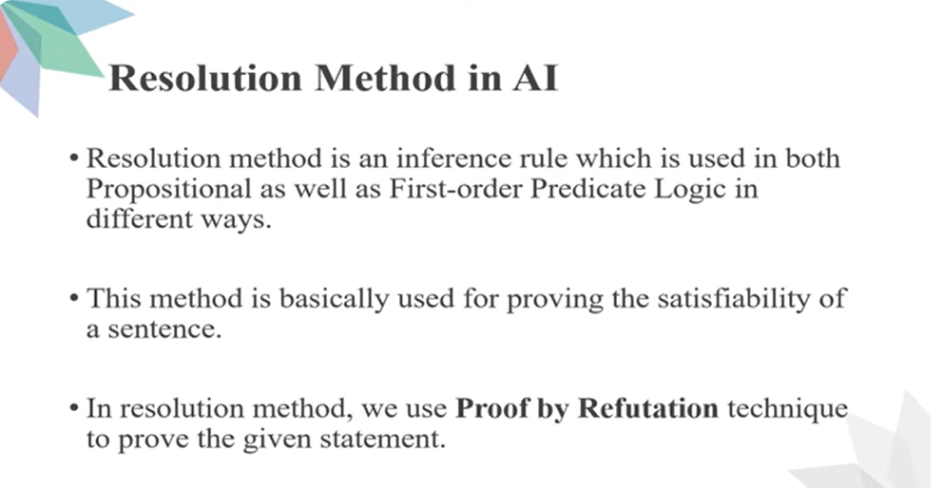

Slide 36
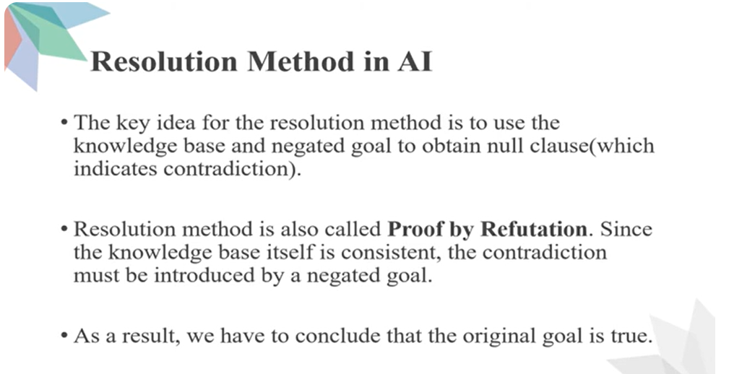

Slide 37
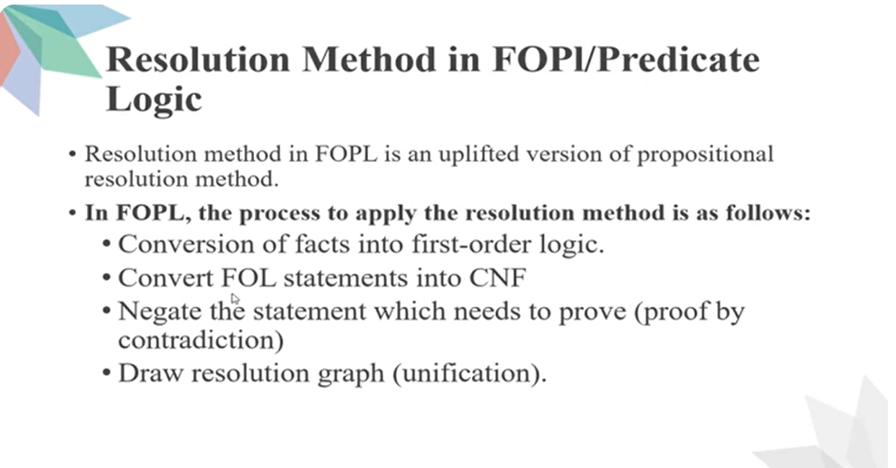

Slide 38
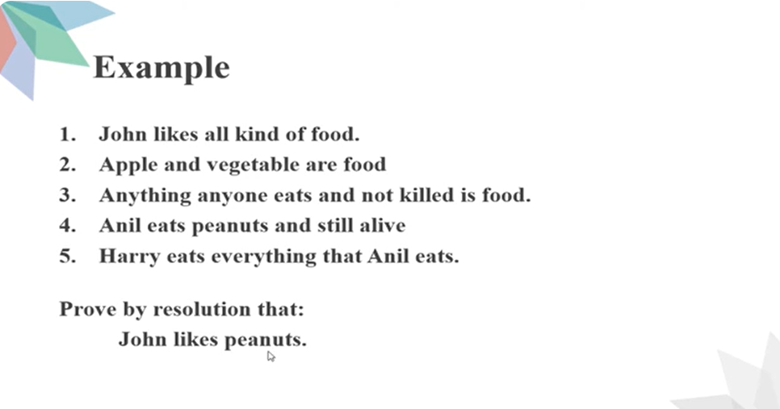

Slide 39
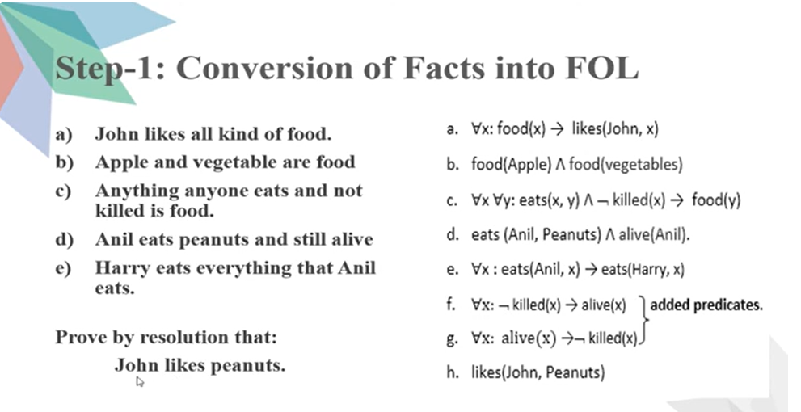

Slide 40
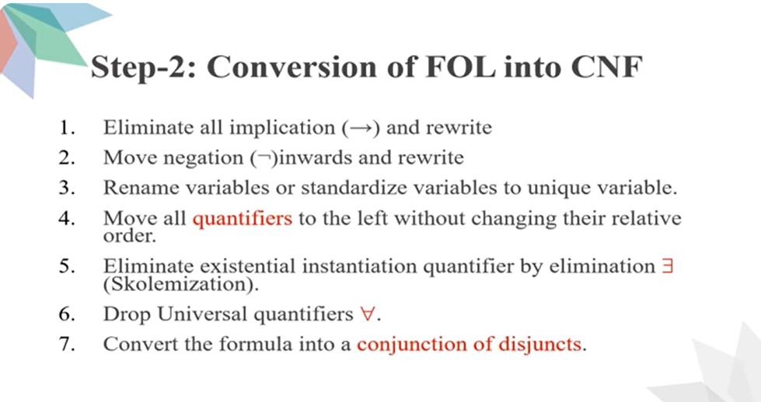

Slide 41
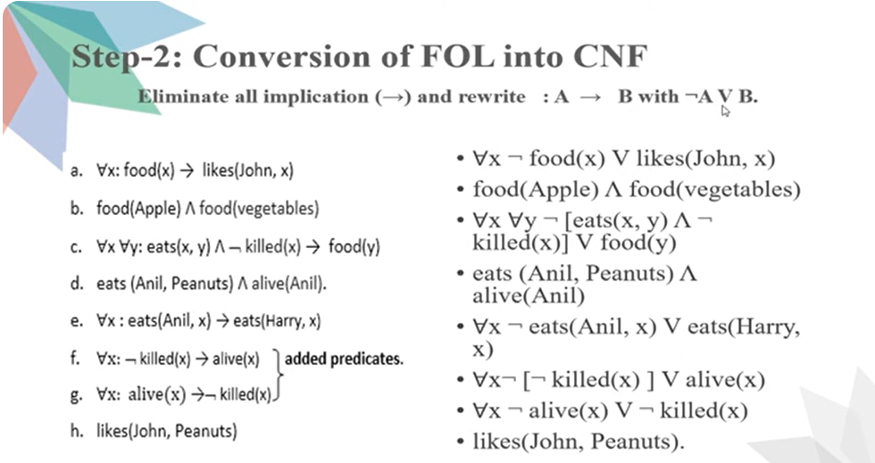

Slide 42
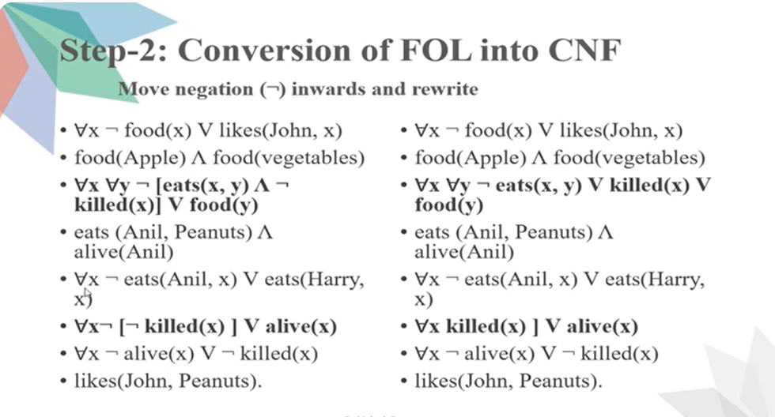

Slide 43
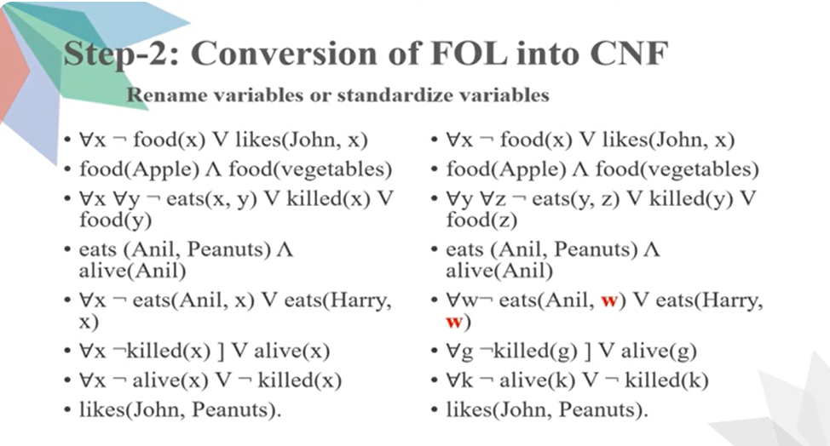

Slide 44
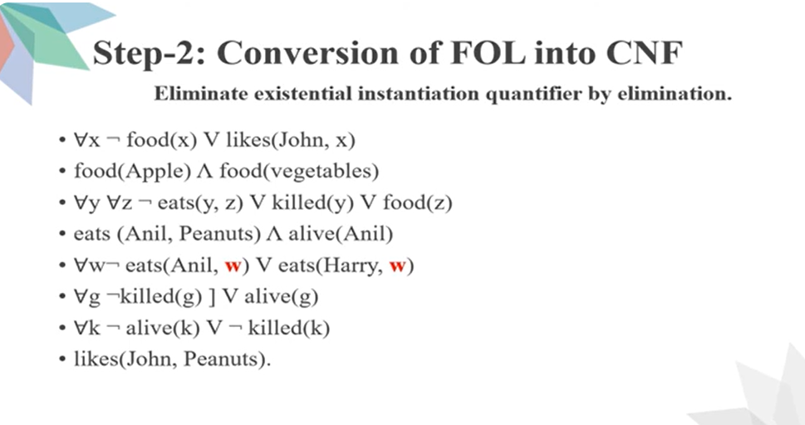

Slide 45
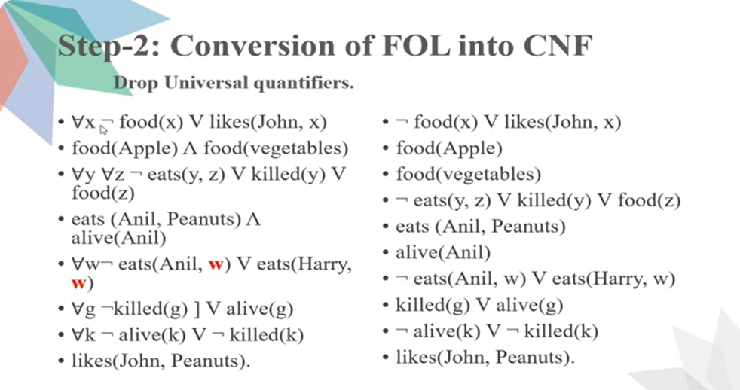

Slide 46
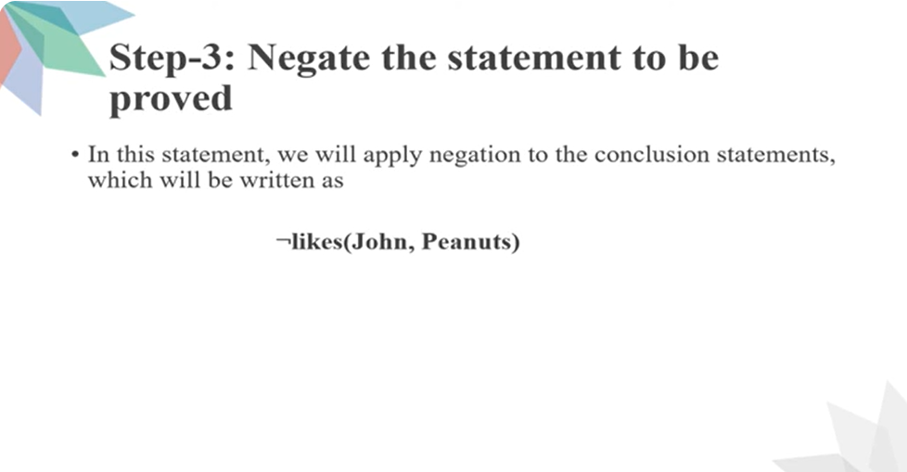

Slide 47
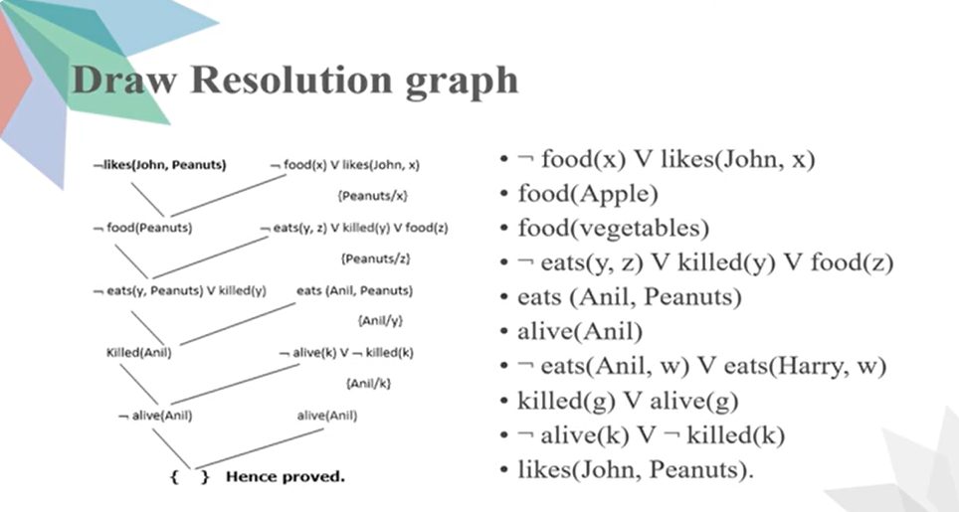

Slide 48
https://www.javatpoint.com/ai-resolution-in-first-order-logic
https://www.youtube.com/watch?v=CbI-Q2a5rUU

Slide 49
Clause Form and Unification Algorithm
These topics are presented in word document

Slide 50

Thank You

